Slide 1


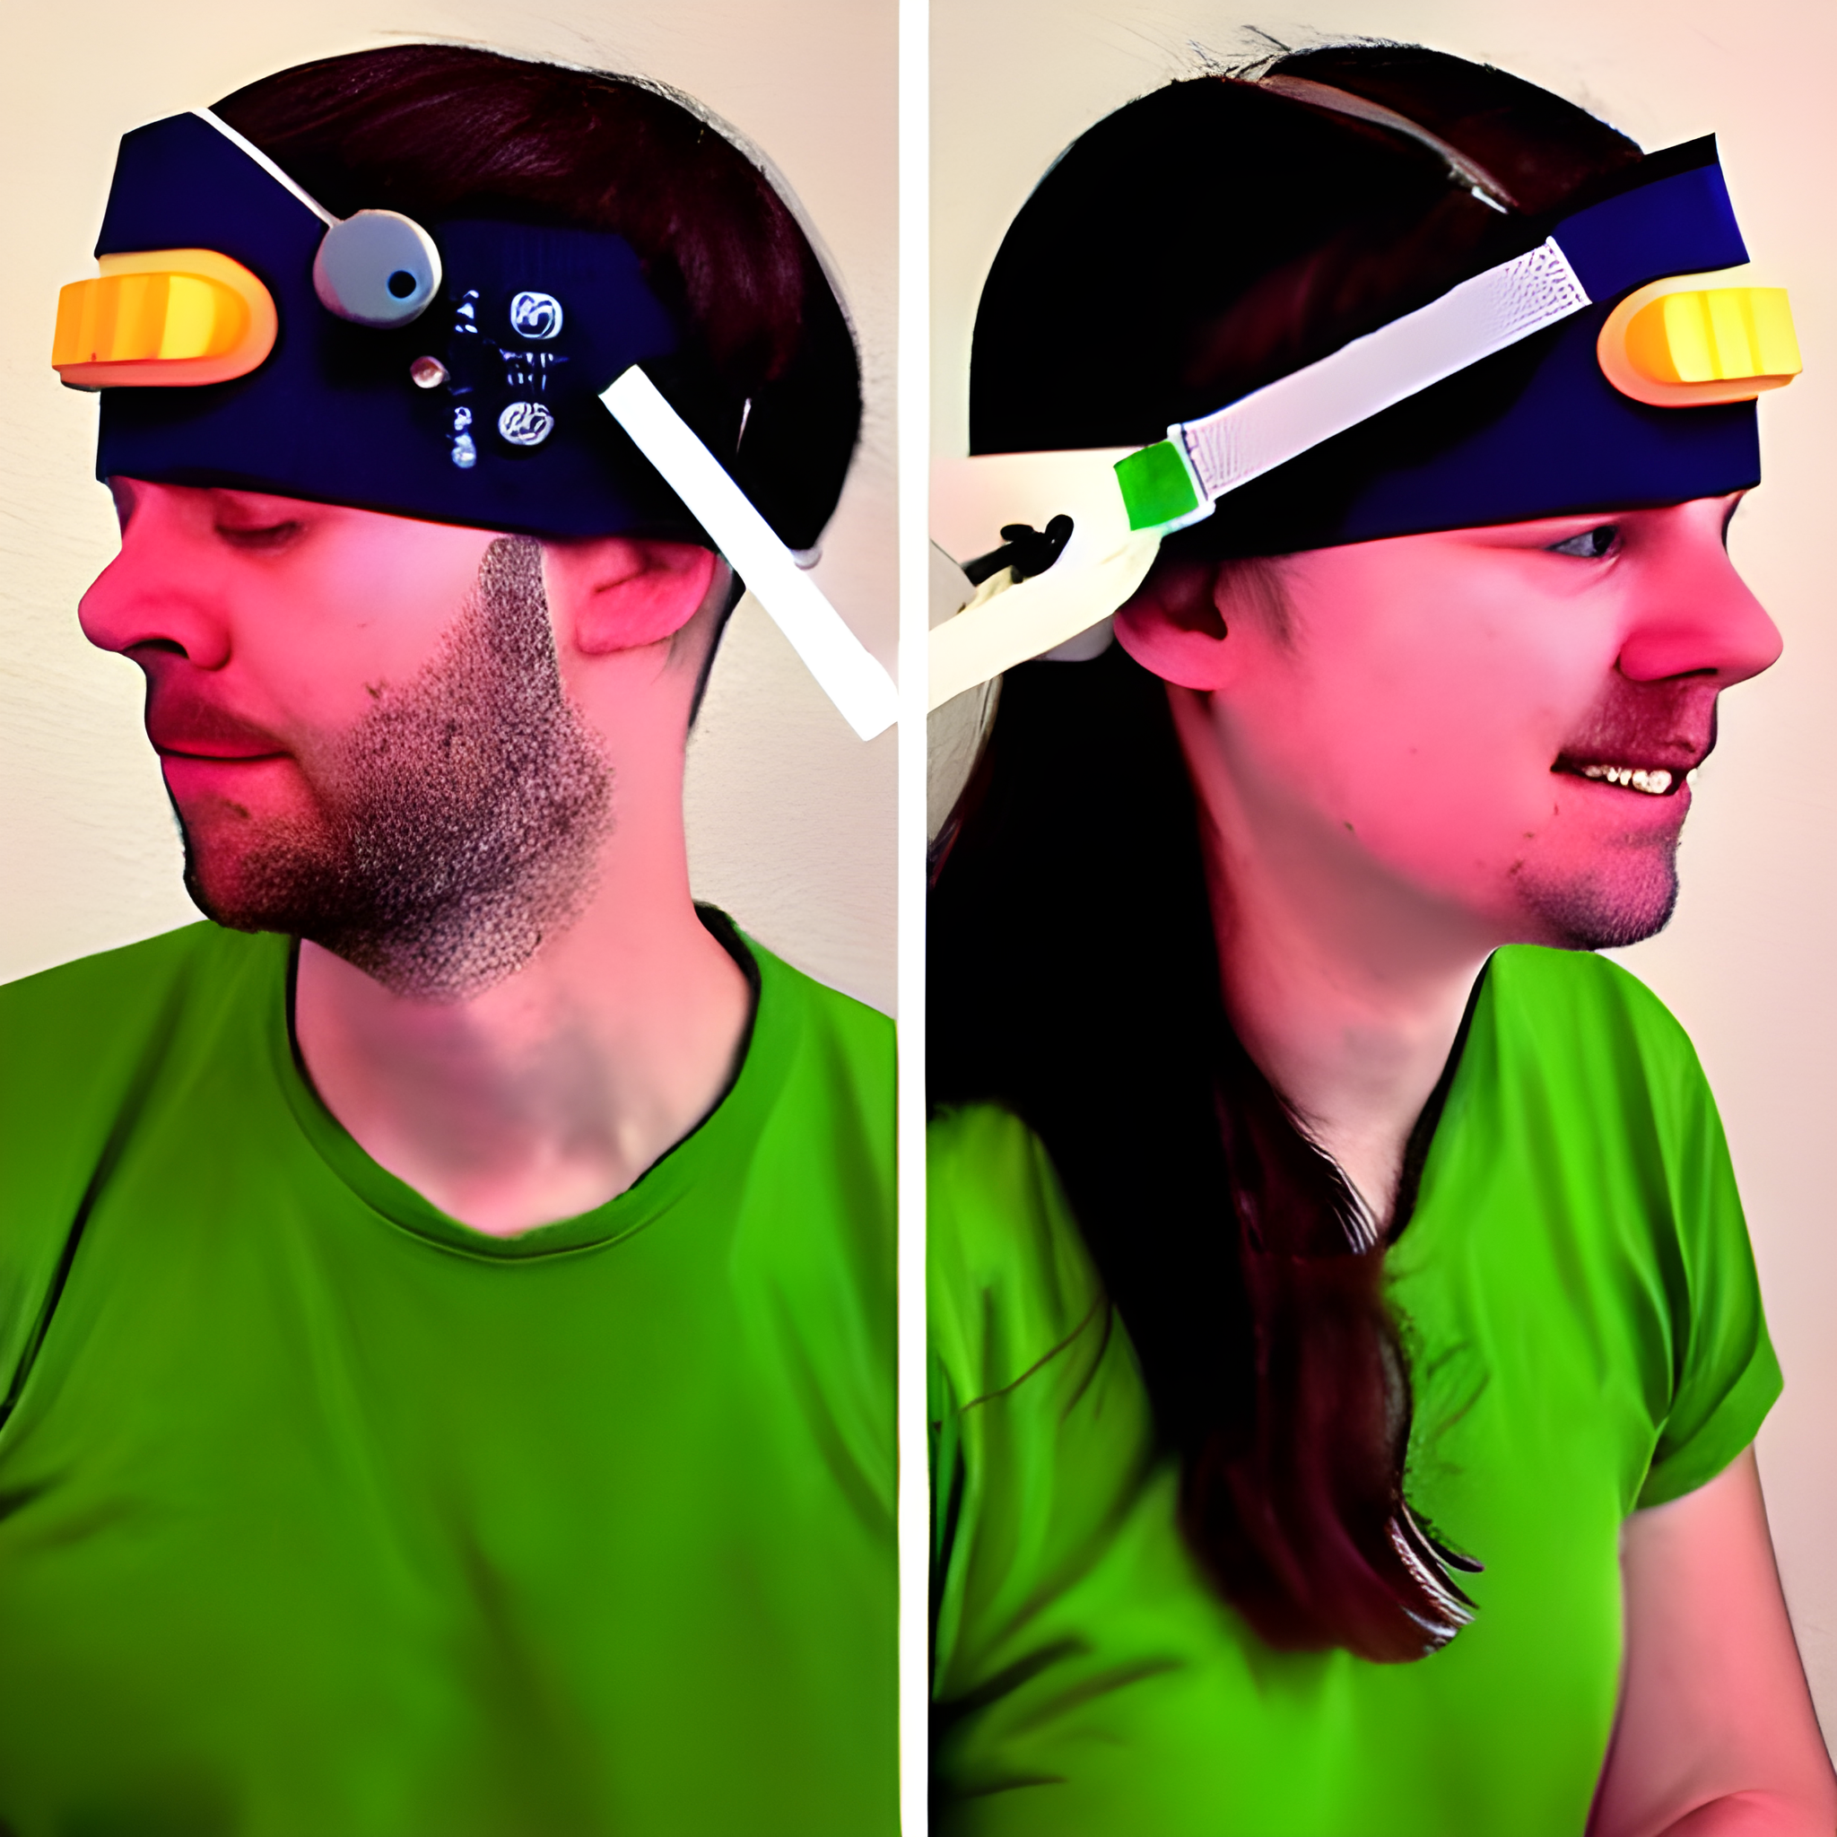

Software and Code
Objective
Develop a wearable device that provides real-time haptic feedback to alert users (such as those with visual impairments) about nearby obstacles.

Slide 2
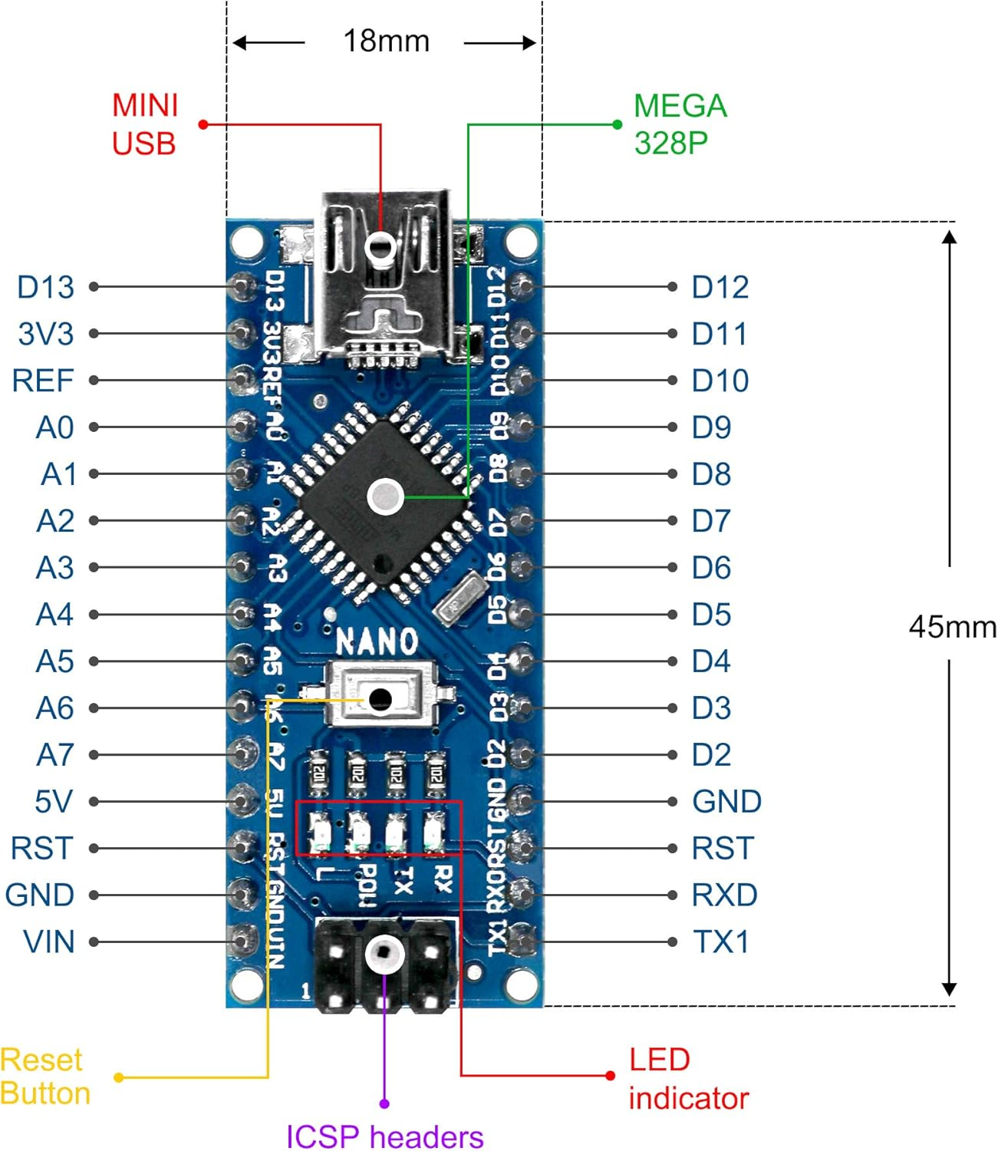
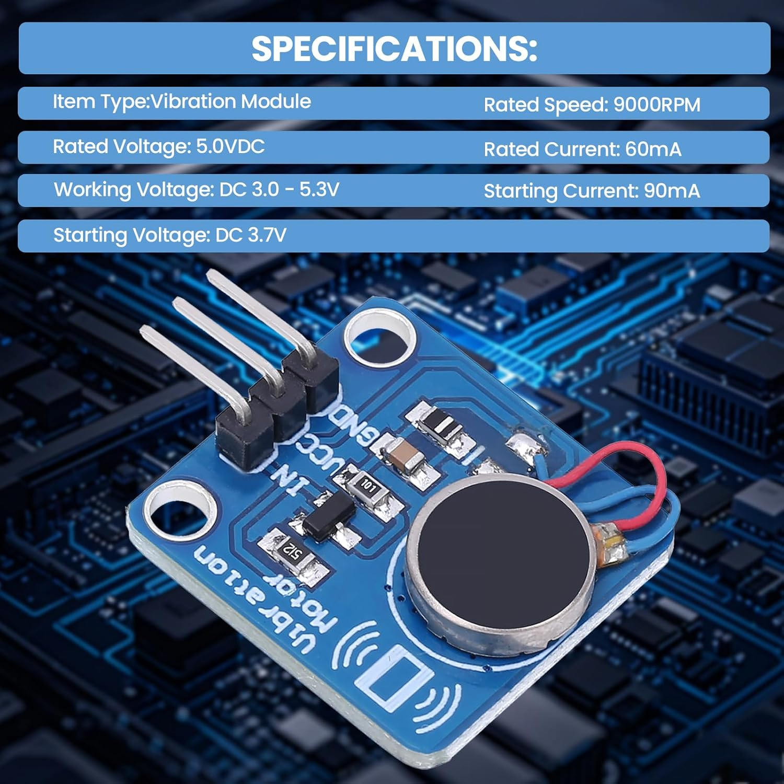

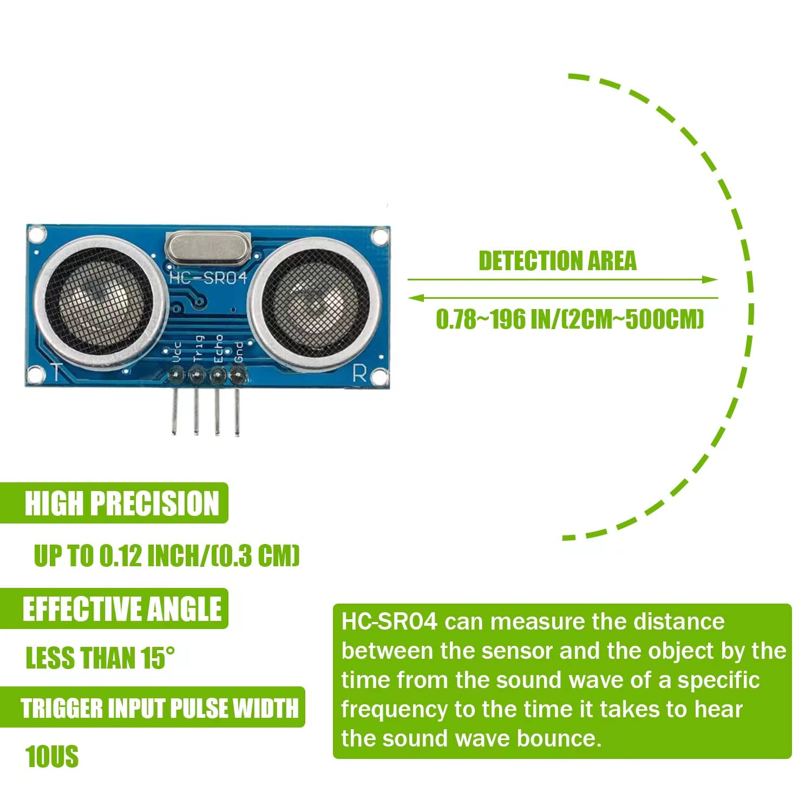
Hardware Components
Arduino Nano (LAFVIN Nano V3.0)
A small, powerful microcontroller (ATmega328P, 16MHz, 32KB flash).
Acts as the brain, reads sensor data and controls vibrations.
EPLZON HC-SR04 Ultrasonic Sensors (Pack of 5)
Measures distance from 2 cm to 500 cm with about 0.3 cm accuracy.
Uses TRIG (sends a 10µs pulse)
ECHO (receives the returning signal) pins.
Vibrating Motor (Jeanoko)
Runs at 5V, 9000 RPM; intensity controlled via (Pulse Width Modulation).
Converts electrical signals into physical vibrations.

Slide 3
Circuit Setup in Tinkercad
Built and simulated the circuit in TinkerCAD using an Arduino Nano?
Wiring Overview
Sensors
TRIG pins connected to digital pins (2, 4, 13, 8, 12).
ECHO pins connected to digital pins (3, 7, A1, A2, A3).
Motors
Connected to PWM-capable digital pins (5, 6, 9, 10, 11).

Slide 4
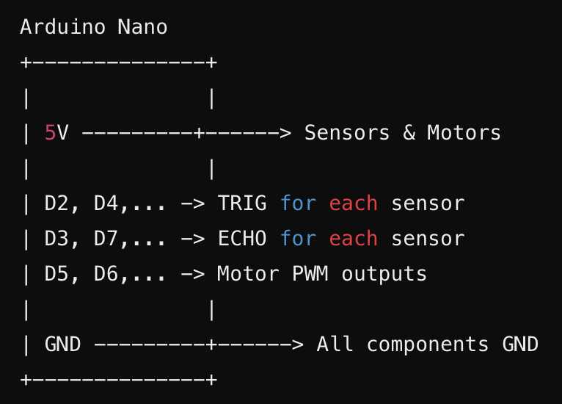
Notes:
This code controls a system of five ultrasonic sensors and five vibration motors using an Arduino. In the setup, the code initializes serial communication at 115200 baud and configures the trigger pins as outputs, the echo pins as inputs, and the motor pins as PWM outputs. In the main loop, each sensor is processed one at a time. For each sensor, a short 10 µs pulse is sent on its trigger pin to emit an ultrasonic burst. The code then measures the duration of the returning echo using pulseIn(), with a 30 ms timeout to prevent delays if no echo is received. If no echo is detected, a high default distance is set. Otherwise, the duration is converted into a distance in centimeters using a conversion factor. This distance is then mapped to a PWM value—objects closer than 5 cm yield maximum vibration (PWM 255), while objects farther than 100 cm yield no vibration (PWM 0), with values in between scaled linearly. Finally, the PWM value is written to the corresponding motor to control its vibration intensity, and a small delay of 50 ms is introduced before processing the next sensor to reduce interference.

Slide 5
Code Overview
How It Works
Data Collection
The HC-SR04 sensors continuously measure the distance to nearby obstacles.
Each sensor is triggered sequentially, and the Arduino calculates the distance from the echo duration.
Data Processing
The measured distance is processed by the Arduino.
The code maps distances between 5 cm and 100 cm to a PWM range of 255 (maximum intensity) to 0 (no vibration).
This mapping is designed so that
Objects closer than 5 cm produce maximum vibration intensity (PWM = 255).
Objects beyond 100 cm yield no vibration (PWM = 0).
Intermediate distances provide proportional feedback.
Notes:
It sets sensor trigger pins as outputs, echo pins as inputs, and motor pins as outputs. In the main loop, each sensor is processed one by one. First, a 10 µs pulse triggers the sensor. Then, the echo is measured with pulseIn(). The echo time is converted into a distance in centimeters. Next, the distance is mapped to a PWM value. If the object is under 5 cm, the motor gets maximum vibration (PWM 255). If the object is over 100 cm, the motor is off (PWM 0). For distances in between, the PWM value is adjusted linearly. Finally, the PWM value is sent to the motor and debug information is printed. The loop then waits 50 ms before processing the next sensor.

Slide 6
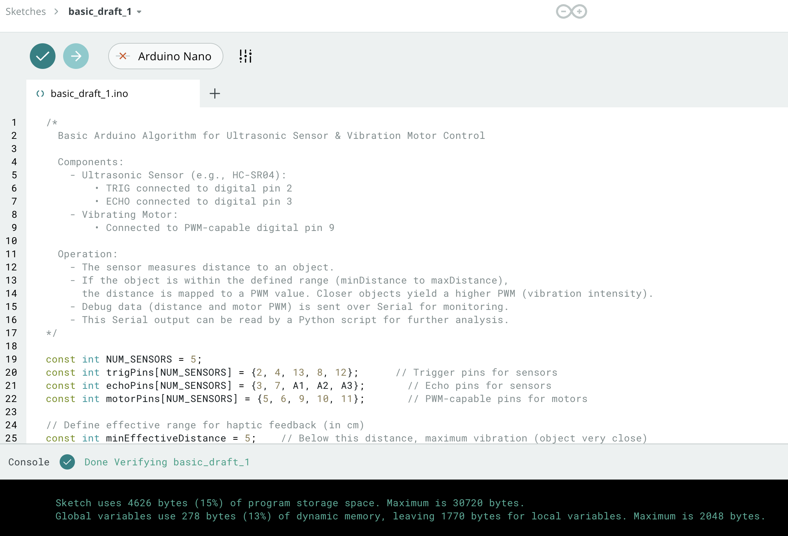
Basic Draft Code Basic Arduino Algorithm for Ultrasonic Sensor & Vibration Motor Control

Slide 7
Future Enhancements
Multi-Sensor Array
Use additional sensors for better directional feedback.
Advanced Haptic Patterns
Develop varied vibration patterns (e.g., pulsating) to convey more detailed information.
Audio Feedback
Integrate a buzzer or speaker to provide audio alerts along with vibrations.
User Calibration
Allow users to adjust sensitivity and vibration levels for a personalized experience.
Battery Monitoring
Implement a system to monitor battery life for continuous, reliable operation.
Remote Connectivity
Add Bluetooth or Wi-Fi for remote configuration and data logging.

